Slide 1
Weekly trading approach

Slide 2
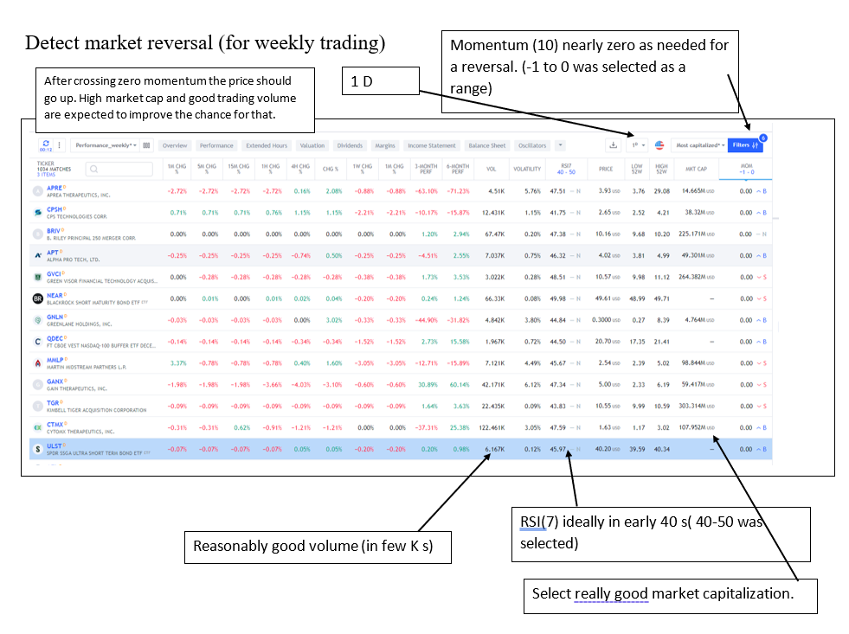

Slide 3
Guidelines for each selection
1^{D:} View 1day stats as we are looking for weekly market reversal.
MOM: Try to use momentum in the range of -1 to 0 as we are interested in potential soon reversals.
VOL: Use a recorded reasonably high volume during past 24 hours to make sure the stock is in active range. We use stocks with few K’s.
MKT CAP: Get the market cap at least above 100 million. This is to increase the chance of having solid increment.
RSI: Narrow down the oversold stocks. Stay within the range of 40 to 50.

